Slide 1


FC Porto Board Ironhack Sport Div.
“Kick-off” Analysis
October 2022

Slide 2
Main Objectives
Make a current Porto’s team data-based analysis.
Find insights and recommendations that lead Porto to:
Improve Performance(OVA)/Budget ratio (1 year).
Stay as Portuguese league TOP 1 club (2 years).
Reach the Champions League semi-finals (4 years).

Slide 3
Content
Ligue Analysis
Self Analysis
Market Analysis
Recommendations
Action Plan

Slide 4
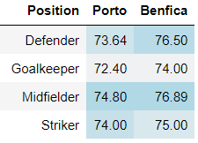
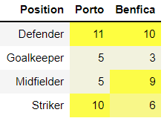


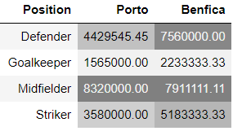
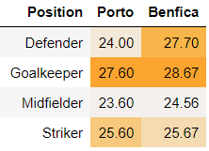
Ligue Analysis
Performance
Team Mix
Team Value
Age

Slide 5
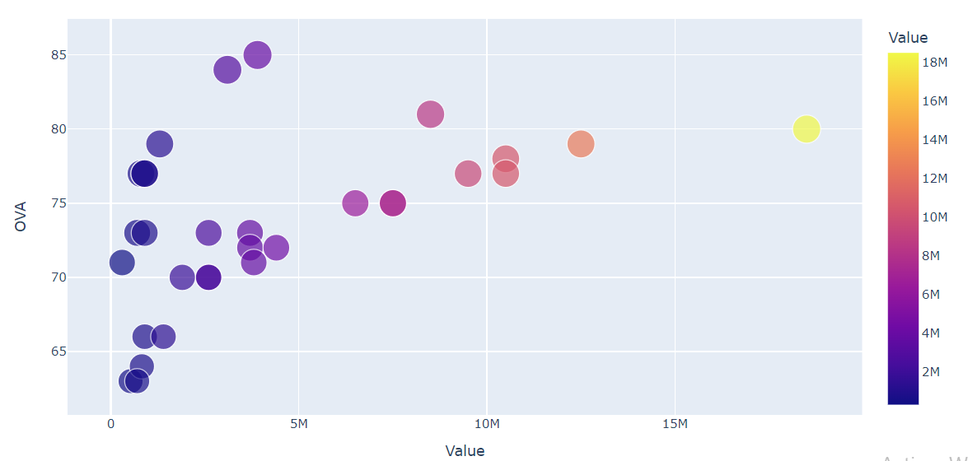

Self Analysis
Performance-Value

Slide 6
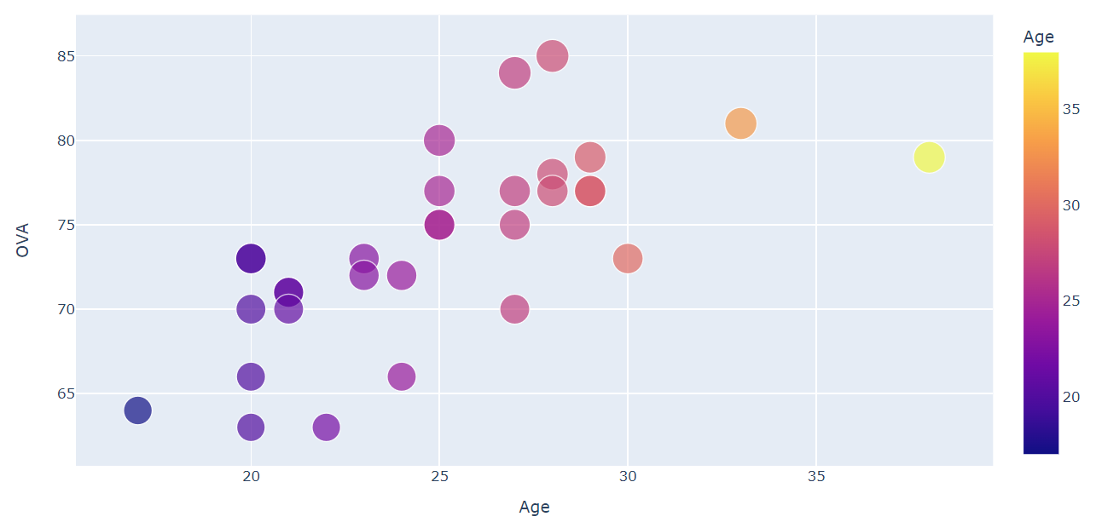
Self Analysis
Performance-Age

Slide 7
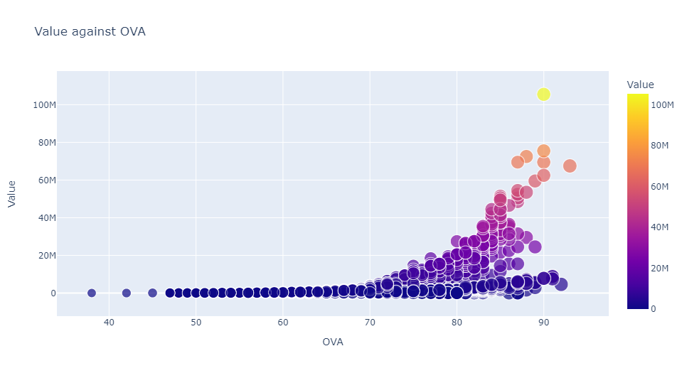
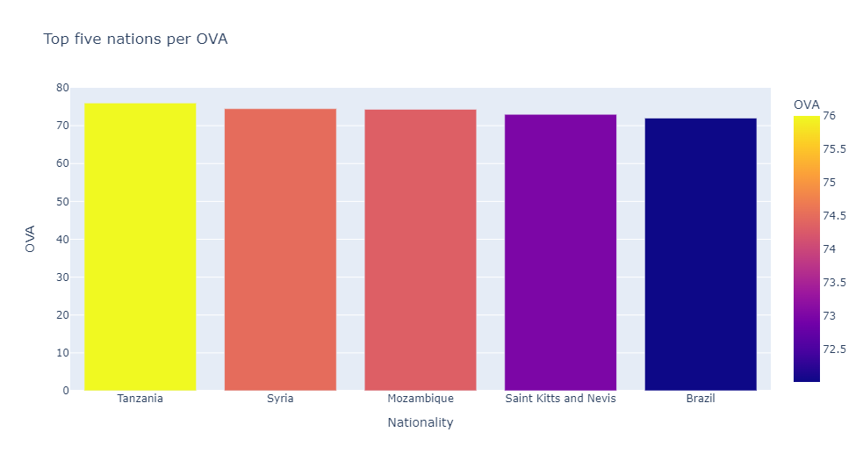

Market Analysis

Slide 8
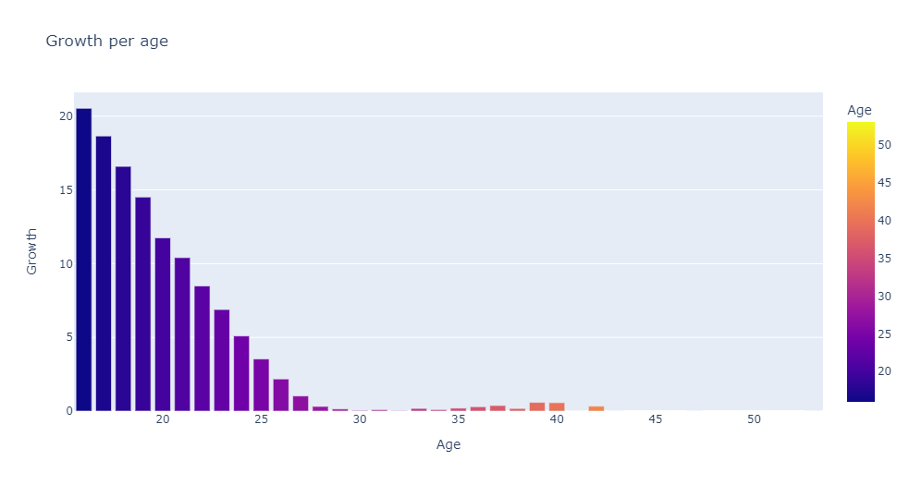
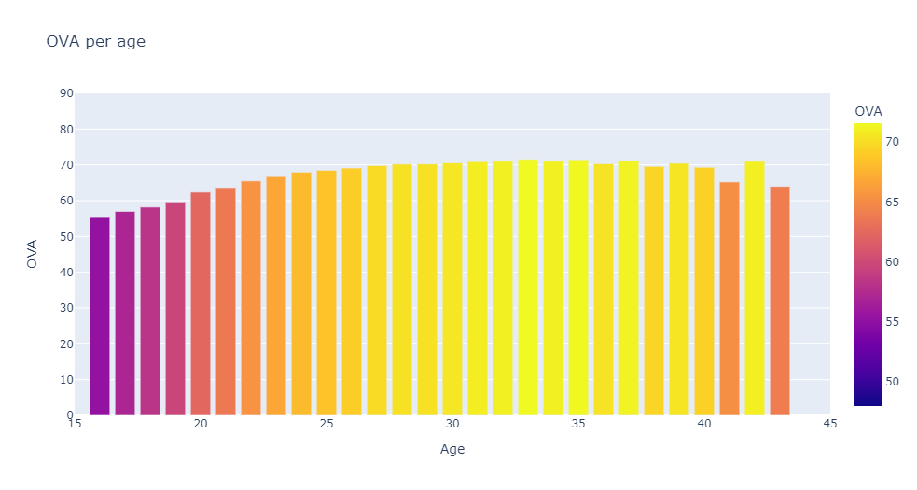
Market Analysis

Slide 9
Recommendations
Selling 5 players for 4,35 million €
4 new low-cost signings:
One skilled striker from SL Benfica to motivate our fans and increase rivalry
One Brazilian striker with higher International Reputation (average=1.32)
Get a more skilled Right Wing Back
Get a more skilled Central Attacking Midfielder

Slide 10
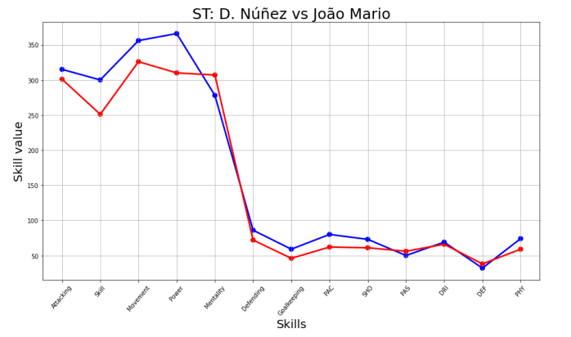
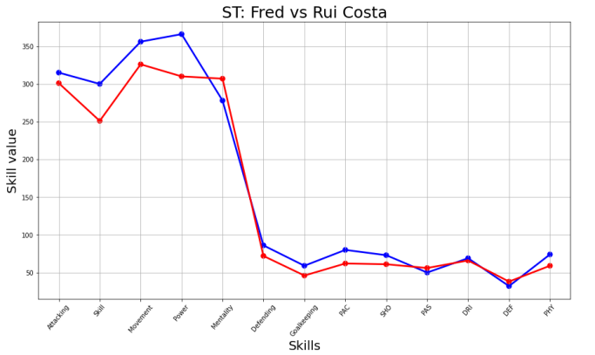
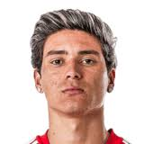



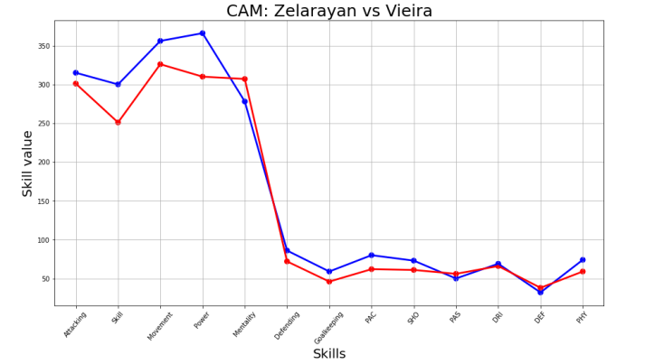
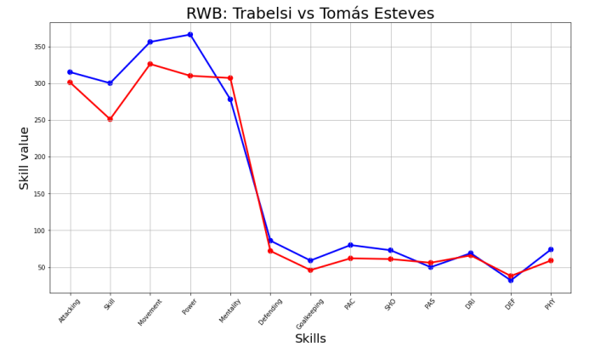
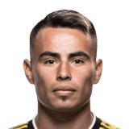



Recommendations
In Blue: new signings

Slide 11
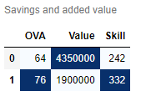
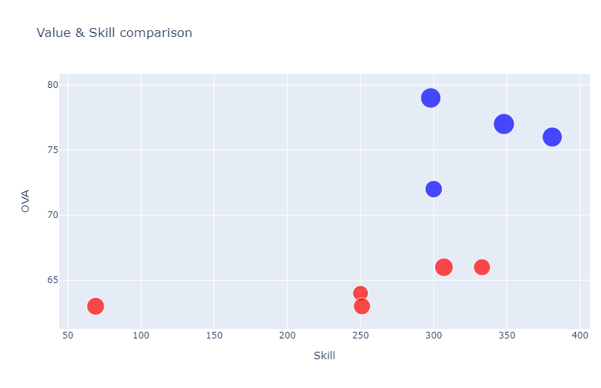
Recommendations
2,45 million in savings
12 OVA points
90 Skill points
In Blue: new signings

Slide 12

Go Portistas!!!!

